Slide 1
What is Archived in PDB Amitava Roy
Some materials are borrowed from the PDB 101 resources and from Dr. Shuchismita Dutta

Slide 2
Today’s Instructor
Amitava Roy, PhD
Faculty affiliate at the Department Of Biomedical And Pharmaceutical Sciences, University of Montana
Research interest: Computational Structural Biology and Drug Development
Email: amitava.roy@umontana.edu

Slide 3
Objectives
What is Archived in the PDB?

Slide 4
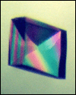
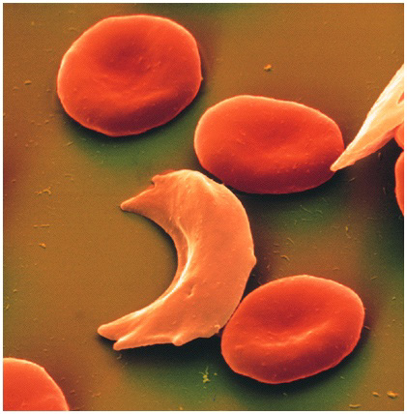

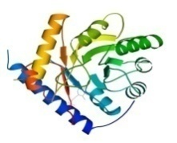
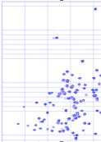
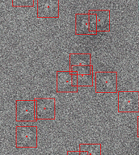
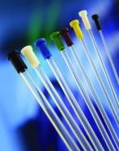



The Data Pipeline
Genomic
Based Target
Selection
Isolation,
Expression,
Purification,
Crystallization
Data
Collection
Structure
Determination
PDB Deposition
& Release
3D Models
Annotations
Publications
You come here
www.rcsb.org • info@rcsb.org

Slide 5
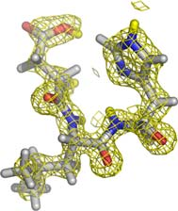
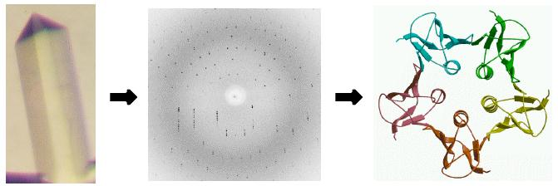
X-ray Crystallography
Target selection
Protein production
Crystallization
Structure calculation
Refinement
Validation
Deposition to PDB
Annotation
Data collection
Phasing
http://www-structmed.cimr.cam.ac.uk/Course/Overview/Overview.html#methods

Slide 6
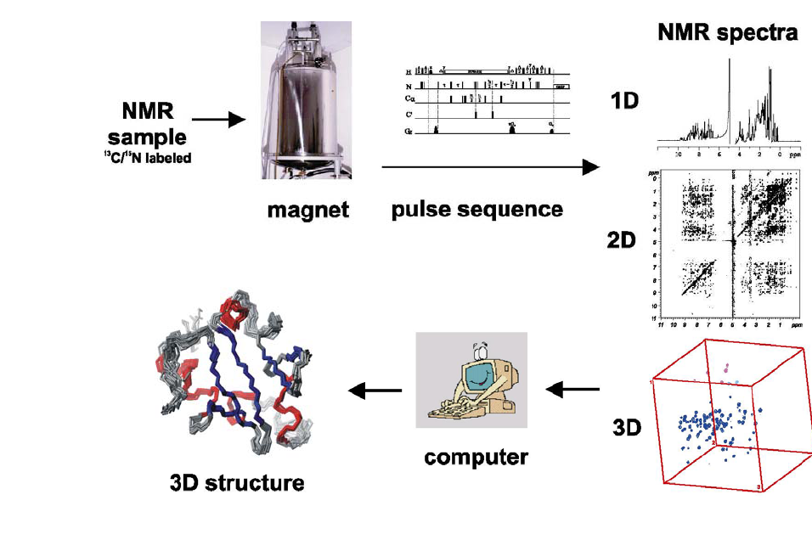
Nuclear Magnetic Resonance (NMR)
http://www.embl.de/nmr/sattler/teaching

Slide 7
Electron Microscopy (EM)
Courtesy, Cathy Lawson, Rutgers University

Slide 8
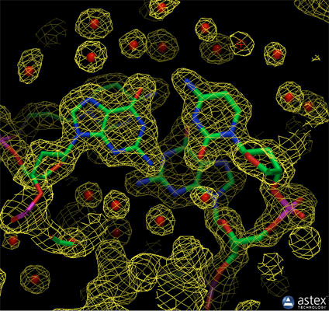
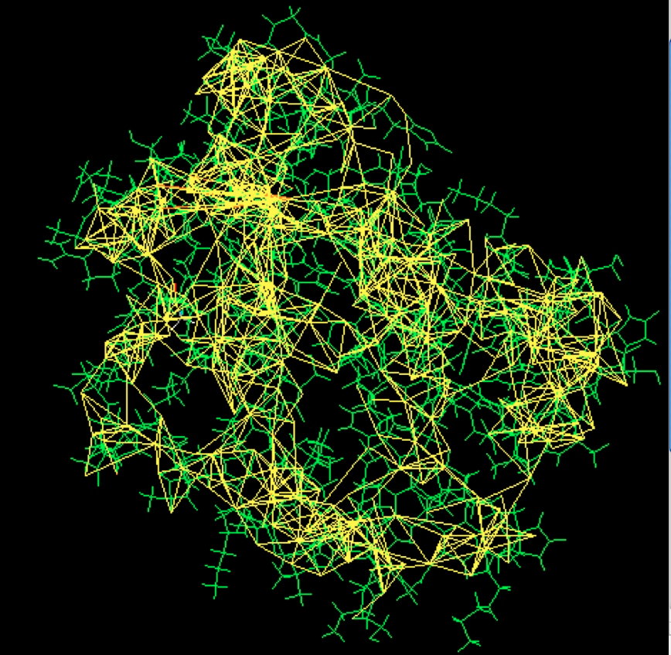
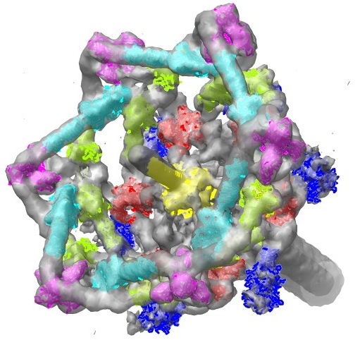
Experimental Data from Different Methods
X-ray Crystallography: Electron density from a structure of DNA is shown here (PDB entry 196d), along with the atomic model
NMR: Restraints used to solve the structure of a small monomeric hemoglobin. The protein (1vre and 1vrf) is shown in green, and restraints are shown in yellow.
EM: Tail of the T4 bacteriophage. Surface rendering of the EM data (emd-1048) with atomic coordinates from PDB entries 1pdf, 1pdi, 1pdl, 1pdm, 1pdp, and 2fl8.

Slide 9
Expanding the limits of PDB
There are many millions of proteins whose structures have not yet been solved.
In 2020, two different projects [AlphaFold2 (Jumper, J. et al., 2021, Varadi M. et al., 2022) and RoseTTAFold (Baek et al., 2021)] used artificial intelligence (AI) and machine learning (ML) to predict protein structures from their sequences successfully.
To make it easier for users to query, organize, visualize, analyze and compare experimental and predicted structures alongside each other, RCSB PDB has integrated Computed structure models (CSMs) from a few specific resources.

Slide 10
What is in the PDB?
Coordinate and experimental data files
Details about sample preparation, data collection and structure solution
Sequence(s) of polymers (proteins and nucleic acids) in the structure
Information about ligands in the structure
Coordinate from computational structure models
Links to various resources that describe the sequence, function and other properties of the molecule.
Classification of structures by sequence, structure, function and other criteria
Download/Use directly
Link to/Find similar

Slide 11
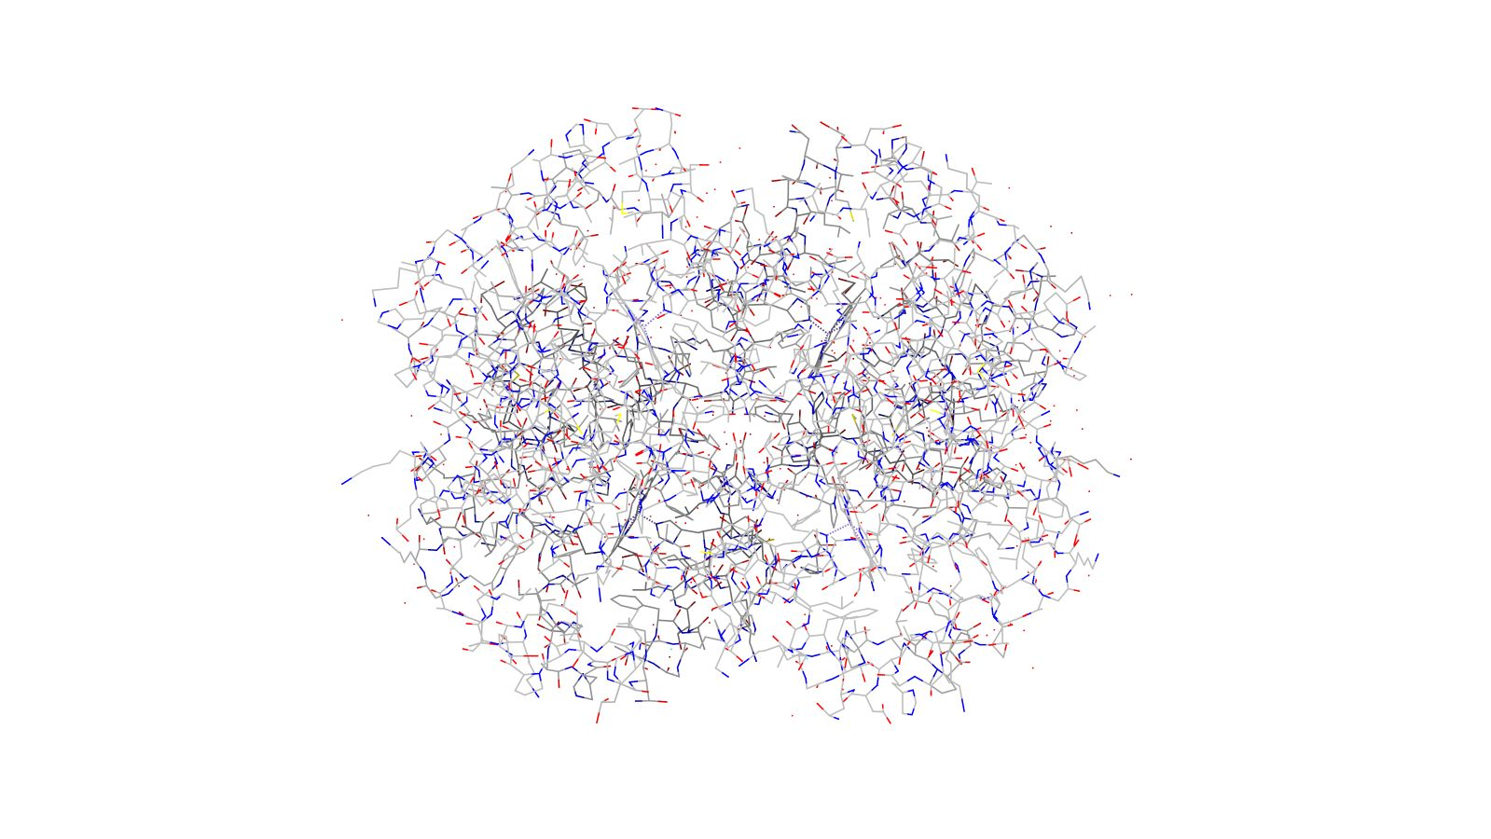
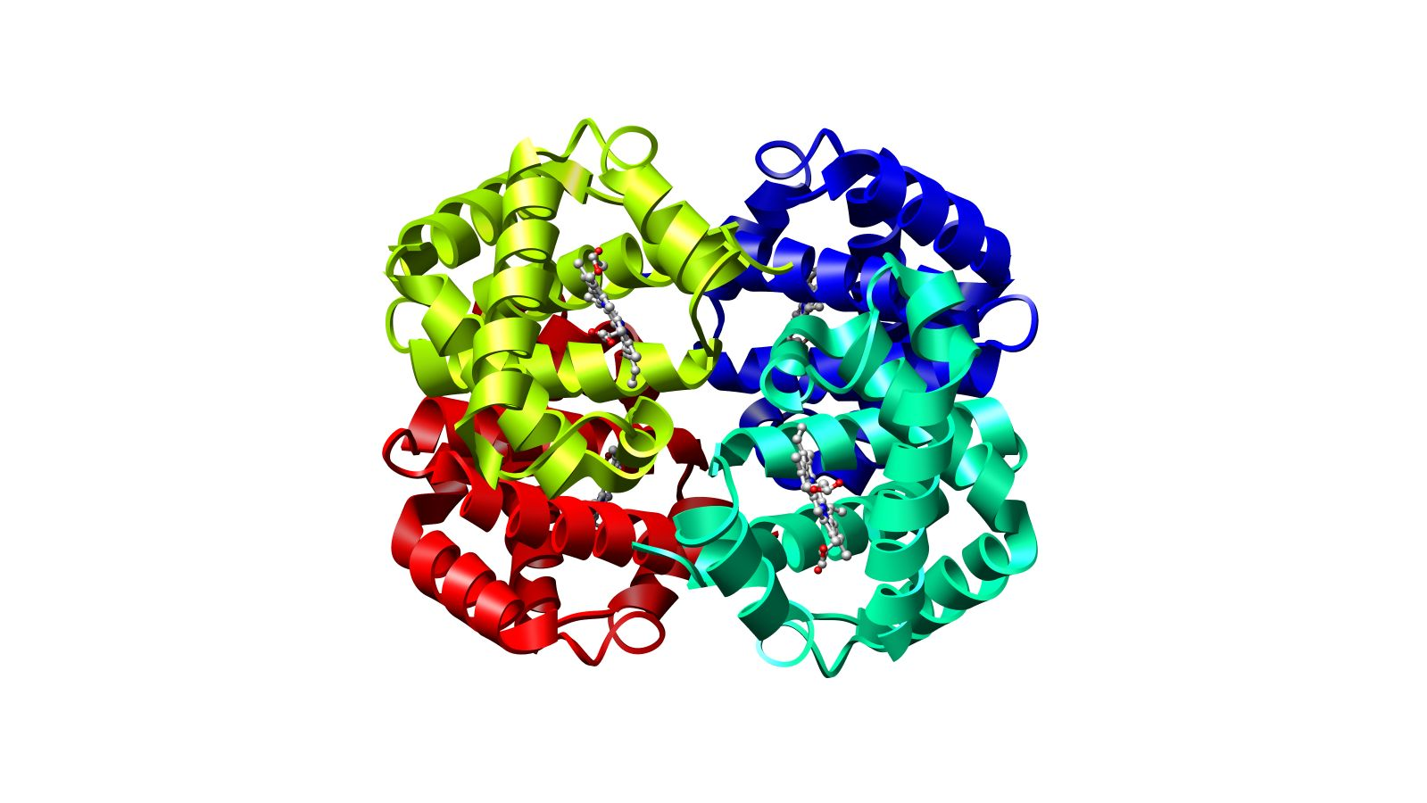
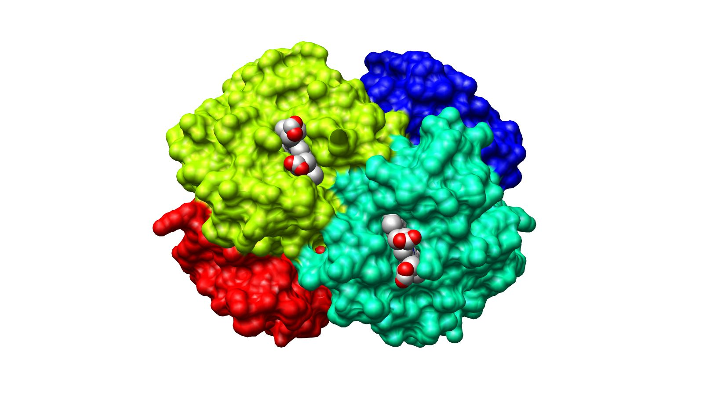
Visualization Conventions
Wireframe
Ribbons
All atoms seen
Only backbone C-alpha atoms seen
Spacefill
All atoms seen

